Slide 1
Information Gain,
Decision Trees and Boosting
10-701 ML recitation
9 Feb 2006
by Jure

Slide 2
Entropy and
Information Grain

Slide 3
Entropy & Bits
You are watching a set of independent random sample of X
X has 4 possible values:
P(X=A)=1/4, P(X=B)=1/4, P(X=C)=1/4, P(X=D)=1/4
You get a string of symbols ACBABBCDADDC…
To transmit the data over binary link you can encode each symbol with bits (A=00, B=01, C=10, D=11)
You need 2 bits per symbol

Slide 4
Fewer Bits – example 1
Now someone tells you the probabilities are not equal
P(X=A)=1/2, P(X=B)=1/4, P(X=C)=1/8, P(X=D)=1/8
Now, it is possible to find coding that uses only 1.75 bits on the average. How?

Slide 5
Fewer bits – example 2
Suppose there are three equally likely values
P(X=A)=1/3, P(X=B)=1/3, P(X=C)=1/3
Naïve coding: A = 00, B = 01, C=10
Uses 2 bits per symbol
Can you find coding that uses 1.6 bits per symbol?
In theory it can be done with 1.58496 bits

Slide 6
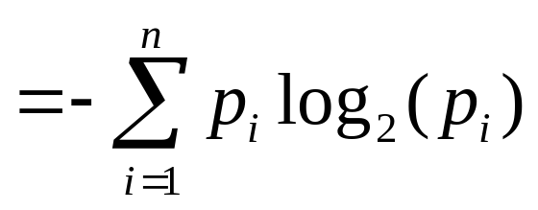
Entropy – General Case
Suppose X takes n values, V₁, V₂,… V_{n}, and
P(X=V₁)=p₁, P(X=V₂)=p₂, … P(X=V_{n})=p_{n}
What is the smallest number of bits, on average, per symbol, needed to transmit the symbols drawn from distribution of X? It’s
H(X) = p₁ log₂ p₁ – p₂ log₂ p₂ – … p_{n}log₂p_{n}
H(X) = the entropy of X

Slide 7
High, Low Entropy
“High Entropy”
  X is from a uniform like distribution
  Flat histogram
  Values sampled from it are less predictable
“Low Entropy”
  X is from a varied (peaks and valleys) distribution
  Histogram has many lows and highs
  Values sampled from it are more predictable

Slide 8
Specific Conditional Entropy, H(Y|X=v)
X = College Major
Y = Likes “Gladiator”
I have input X and want to predict Y
From data we estimate probabilities
P(LikeG = Yes) = 0.5
P(Major=Math & LikeG=No) = 0.25
P(Major=Math) = 0.5
P(Major=History & LikeG=Yes) = 0
Note
H(X) = 1.5
H(Y) = 1
X | Y
Math | Yes
History | No
CS | Yes
Math | No
Math | No
CS | Yes
History | No
Math | Yes

Slide 9
Specific Conditional Entropy, H(Y|X=v)
X = College Major
Y = Likes “Gladiator”
Definition of Specific Conditional Entropy
H(Y|X=v) = entropy of Y among only those records in which X has value v
Example:
H(Y|X=Math) = 1
H(Y|X=History) = 0
H(Y|X=CS) = 0
X | Y
Math | Yes
History | No
CS | Yes
Math | No
Math | No
CS | Yes
History | No
Math | Yes

Slide 10
Conditional Entropy, H(Y|X)
X = College Major
Y = Likes “Gladiator”
Definition of Conditional Entropy
H(Y|X) = the average conditional entropy of Y
= Σ_{i} P(X=v_{i}) H(Y|X=v_{i})
Example:
H(Y|X) = 0.5*1+0.25*0+0.25*0 = 0.5
X | Y
Math | Yes
History | No
CS | Yes
Math | No
Math | No
CS | Yes
History | No
Math | Yes
v_{i} | P(X=v_{i}) | H(Y|X=v_{i})
Math | 0.5 | 1
History | 0.25 | 0
CS | 0.25 | 0

Slide 11
Information Gain
X = College Major
Y = Likes “Gladiator”
Definition of Information Gain
IG(Y|X) = I must transmit Y.
How many bits on average would it save me if both ends of the line knew X?
IG(Y|X) = H(Y) – H(Y|X)
Example:
H(Y) = 1
H(Y|X) = 0.5
Thus:
IG(Y|X) = 1 – 0.5 = 0.5
X | Y
Math | Yes
History | No
CS | Yes
Math | No
Math | No
CS | Yes
History | No
Math | Yes

Slide 12
Decision Trees

Slide 13
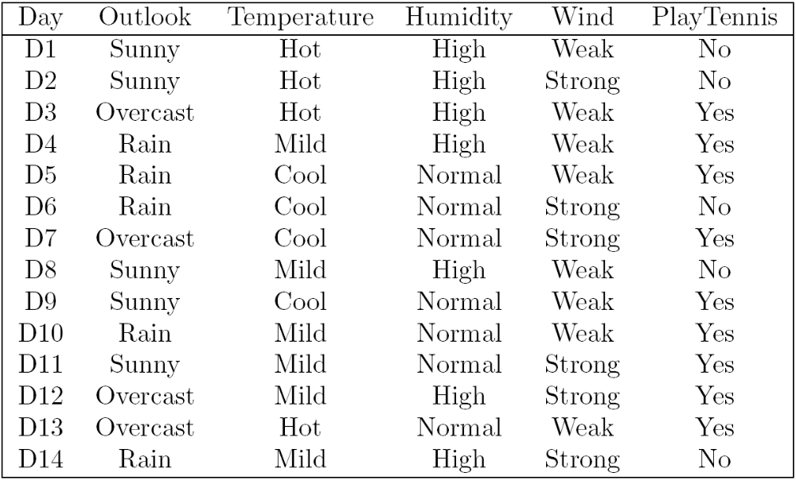
When do I play tennis?

Slide 14
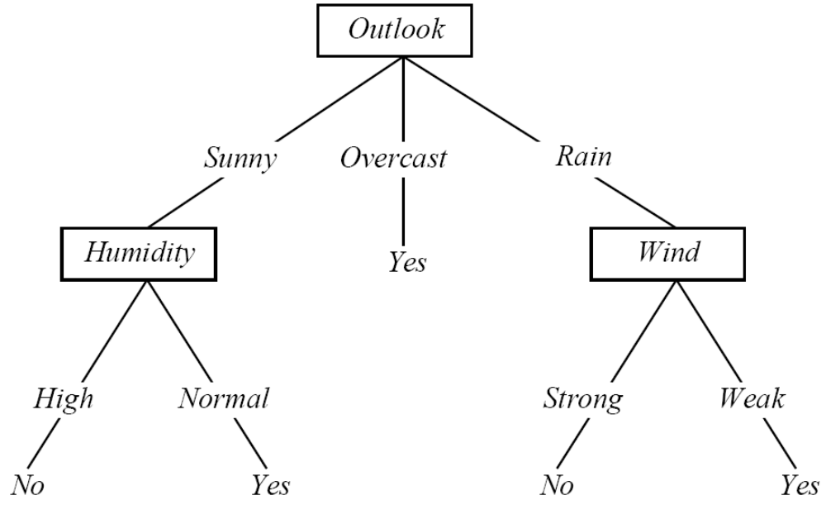
Decision Tree

Slide 15
Is the decision tree correct?
Let’s check whether the split on Wind attribute is correct.
We need to show that Wind attribute has the highest information gain.

Slide 16
When do I play tennis?

Slide 17
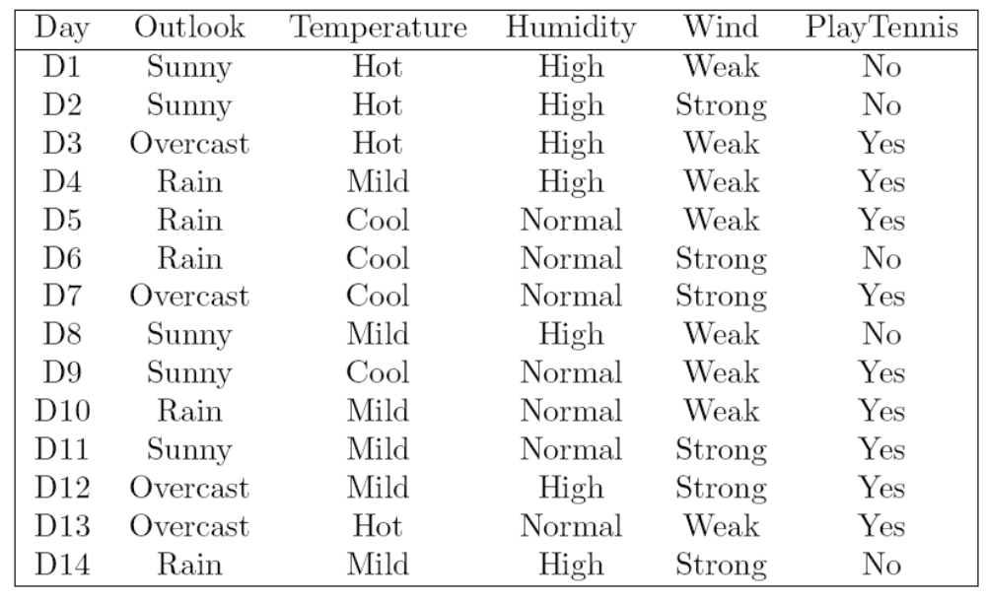
Wind attribute – 5 records match
Note: calculate the entropy only on examples that got “routed” in our branch of the tree (Outlook=Rain)

Slide 18
Calculation
Let
S = {D4, D5, D6, D10, D14}
Entropy:
H(S) = – 3/5log(3/5) – 2/5log(2/5) = 0.971
Information Gain
IG(S,Temp) = H(S) – H(S|Temp) = 0.01997
IG(S, Humidity) = H(S) – H(S|Humidity) = 0.01997
IG(S,Wind) = H(S) – H(S|Wind) = 0.971

Slide 19
More about Decision Trees
How I determine classification in the leaf?
  If Outlook=Rain is a leaf, what is classification rule?
Classify Example:
We have N boolean attributes, all are needed for classification:
  How many IG calculations do we need?
Strength of Decision Trees (boolean attributes)
  All boolean functions
Handling continuous attributes

Slide 20
Boosting

Slide 21
Booosting
Is a way of combining weak learners (also called base learners) into a more accurate classifier
Learn in iterations
Each iteration focuses on hard to learn parts of the attribute space, i.e. examples that were misclassified by previous weak learners.
Note: There is nothing inherently weak about the weak learners – we just think of them this way. In fact, any learning algorithm can be used as a weak learner in boosting

Slide 22
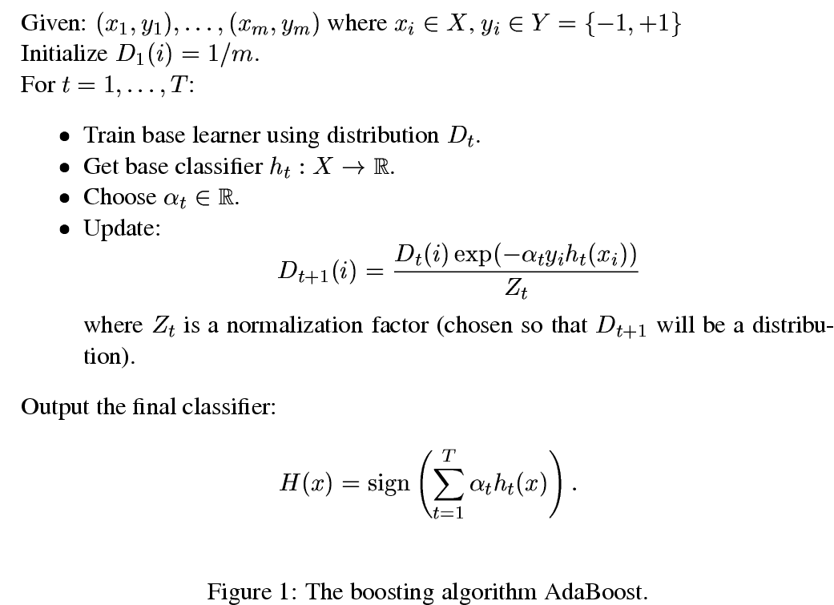
Boooosting, AdaBoost

Slide 23
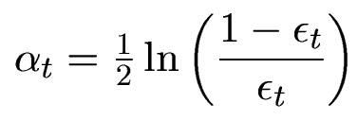
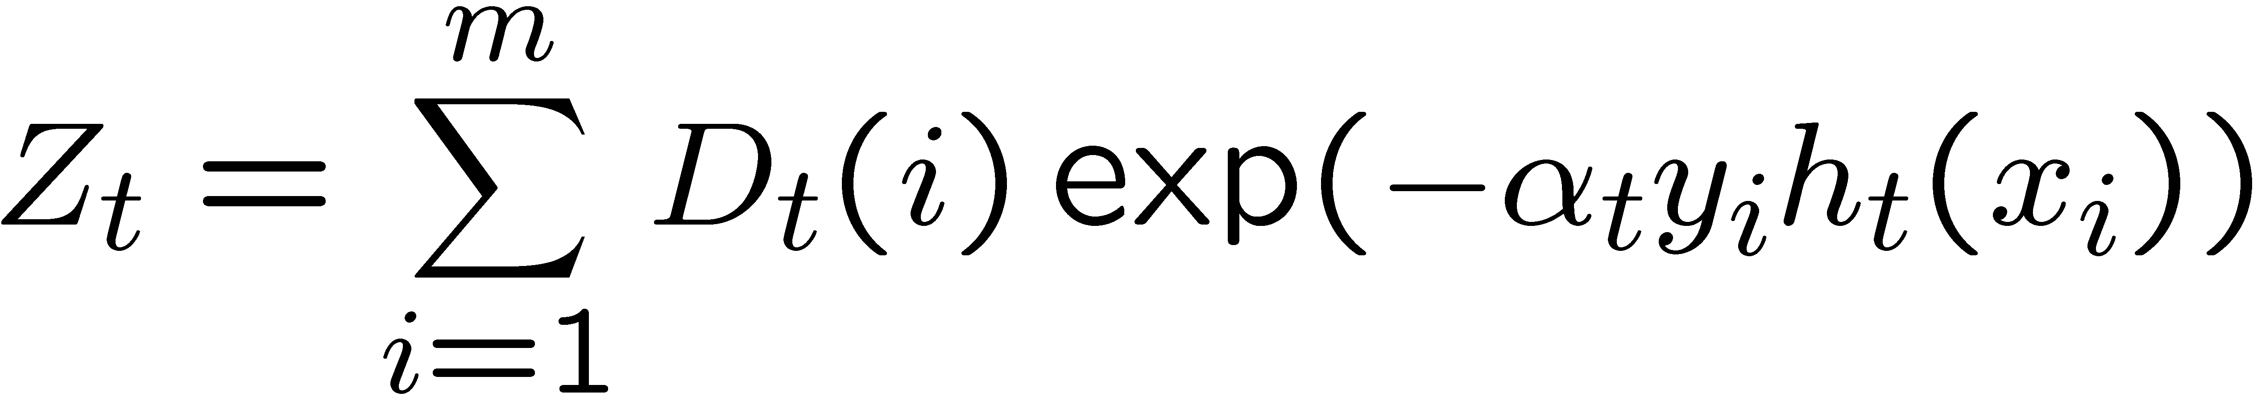
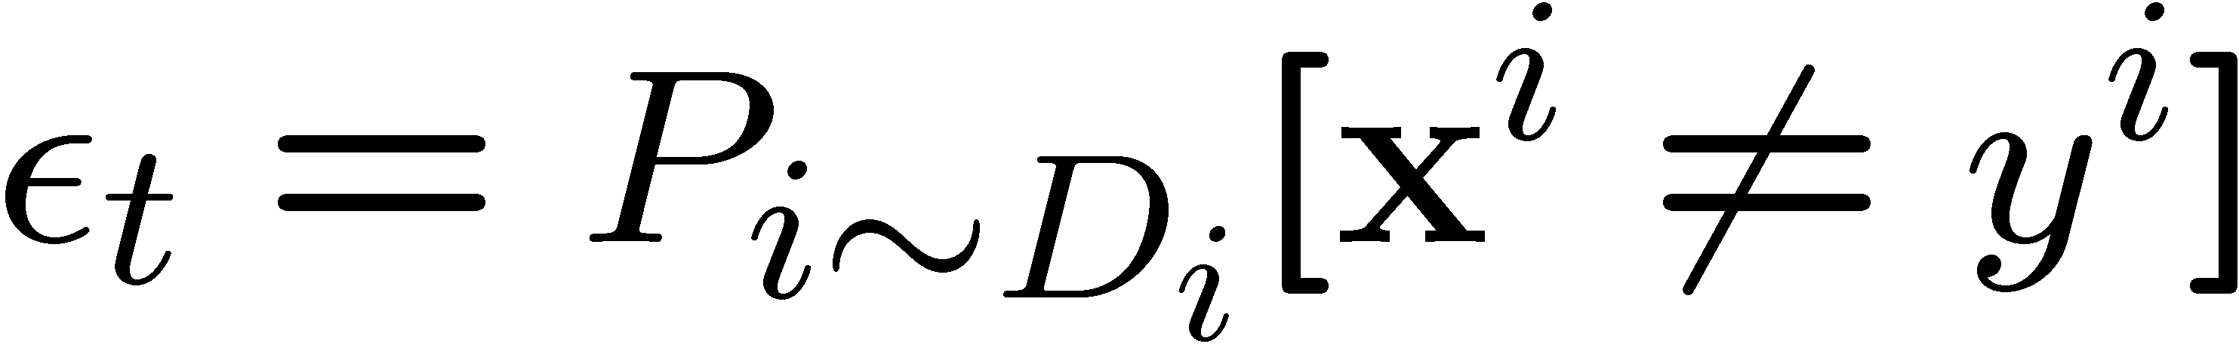
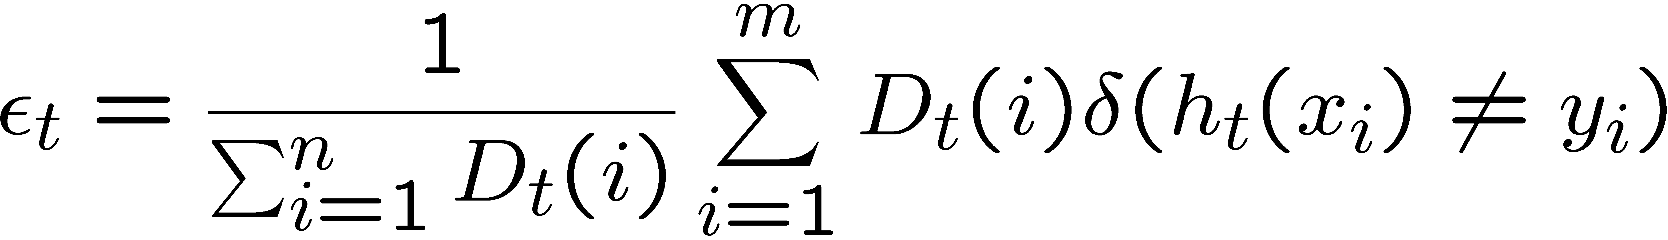
Influence (importance) of weak learner
miss-classifications with respect to weights D

Slide 24
Booooosting Decision Stumps

Slide 25

Boooooosting
Weights D_{t} are uniform
First weak learner is stump that splits on Outlook (since weights are uniform)
4 misclassifications out of 14 examples:
α₁ = ½ ln((1-ε)/ε)
= ½ ln((1- 0.28)/0.28) = 0.45
Update D_{t}:
Determines
miss-classifications

Slide 26
Booooooosting Decision Stumps
miss-classifications
by 1st weak learner

Slide 27
Boooooooosting, round 1
1st weak learner misclassifies 4 examples (D6, D9, D11, D14):
Now update weights D_{t} :
  Weights of examples D6, D9, D11, D14 increase
  Weights of other (correctly classified) examples decrease
How do we calculate IGs for 2nd round of boosting?

Slide 28
Booooooooosting, round 2
Now use D_{t} instead of counts (D_{t} is a distribution):
  So when calculating information gain we calculate the “probability” by using weights D_{t} (not counts)
  e.g.
  P(Temp=mild) = D_{t}(d4) + D_{t}(d8)+ D_{t}(d10)+ D_{t}(d11)+ D_{t}(d12)+ D_{t}(d14)
  which is more than 6/14 (Temp=mild occurs 6 times)
  similarly:
  P(Tennis=Yes|Temp=mild) = (D_{t}(d4) + D_{t}(d10)+ D_{t}(d11)+ D_{t}(d12)) / P(Temp=mild)
  and no magic for IG

Slide 29
Boooooooooosting, even more
Boosting does not easily overfit
Have to determine stopping criteria
  Not obvious, but not that important
Boosting is greedy:
  always chooses currently best weak learner
  once it chooses weak learner and its Alpha, it remains fixed – no changes possible in later rounds of boosting

Slide 30
Acknowledgement
Part of the slides on Information Gain borrowed from Andrew Moore

